Slide 1
Internship studio
Ethical Hacking Internship
Created by Soumyadip halder

Slide 2
Vulnerability Report
Report ID: #Task2-Reflected-XSS
Vulnerability Title: Reflected XSS in search.asp
Vulnerability Type: Reflected Cross-site Scripting
Target URL: http://testasp.vulnweb.com/search.asp
Description:
The searchFor parameter in search.asp is vulnerable to reflected XSS. A crafted script in the URL executes in the browser, allowing an attacker to inject malicious code.
Steps to Reproduce:
Open Firefox with Burp Proxy set.
Visit:
http://testasp.vulnweb.com/search.asp?searchFor=<script>alert('xss')</script>
Observe alert popup.
Payload Used:
<script>alert('xss')</script>

Slide 3
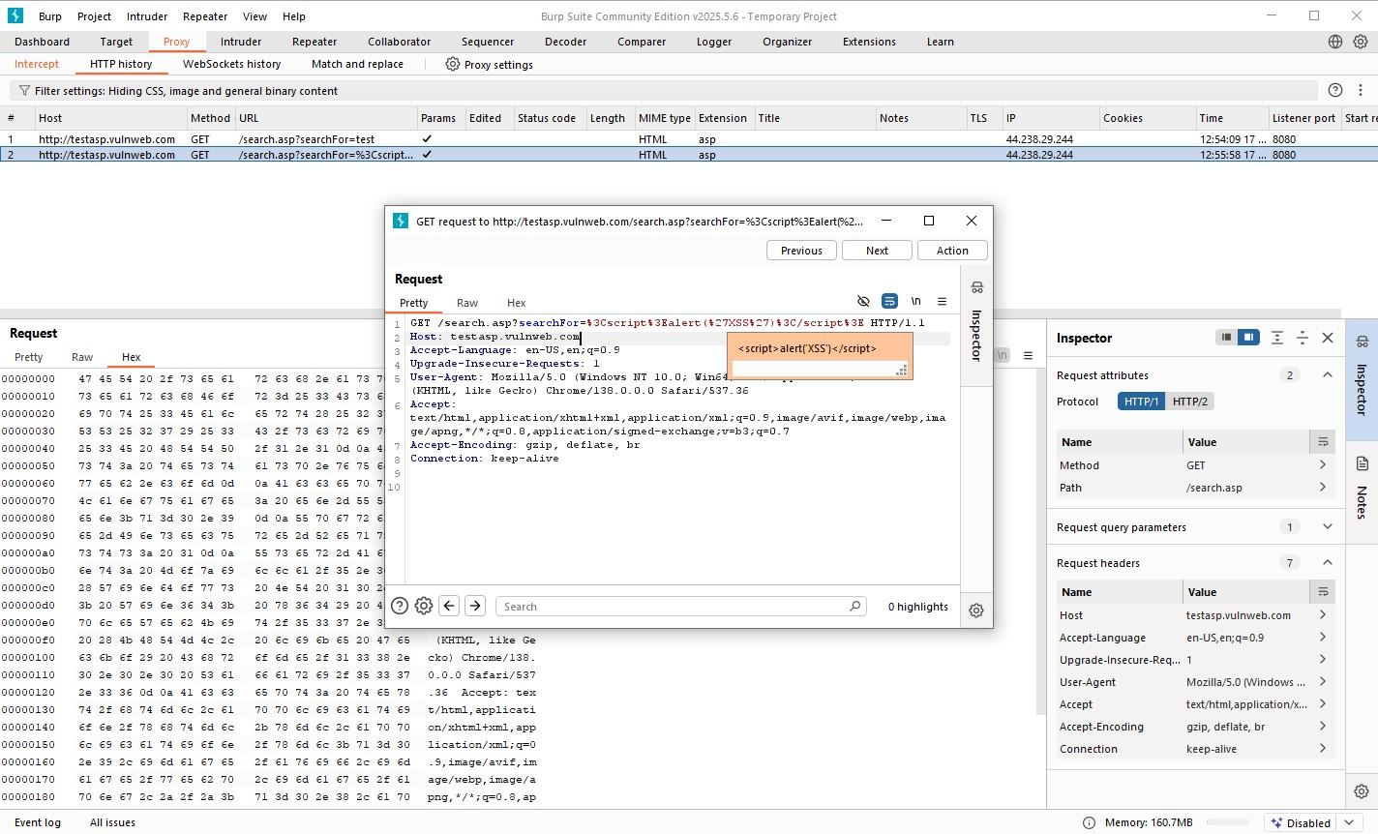

Slide 4
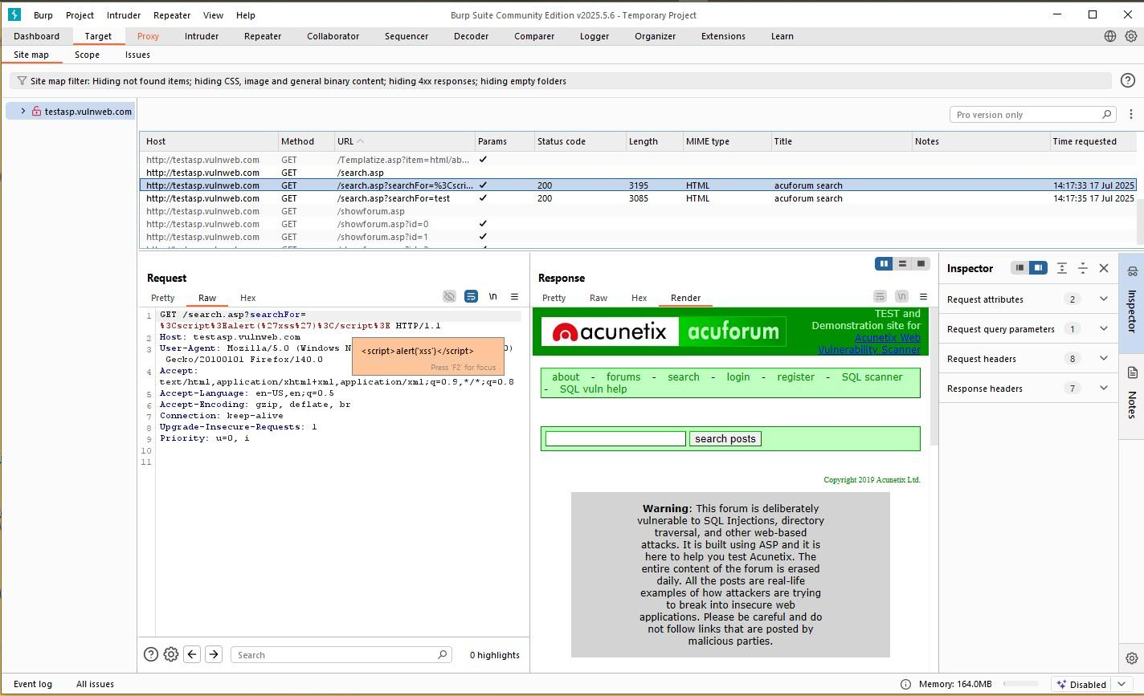

Slide 5
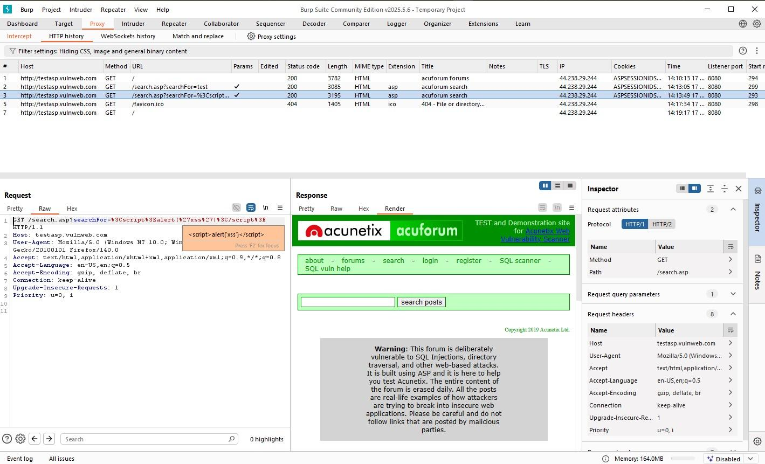

Slide 6
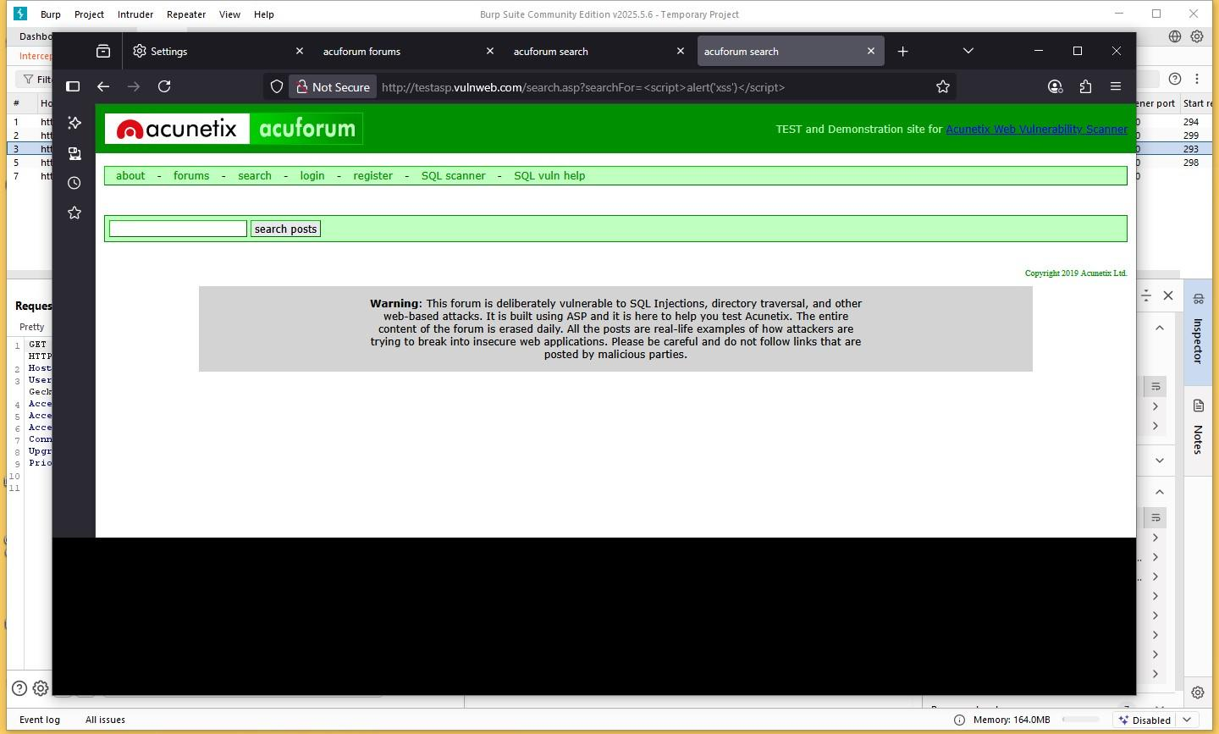

Slide 7
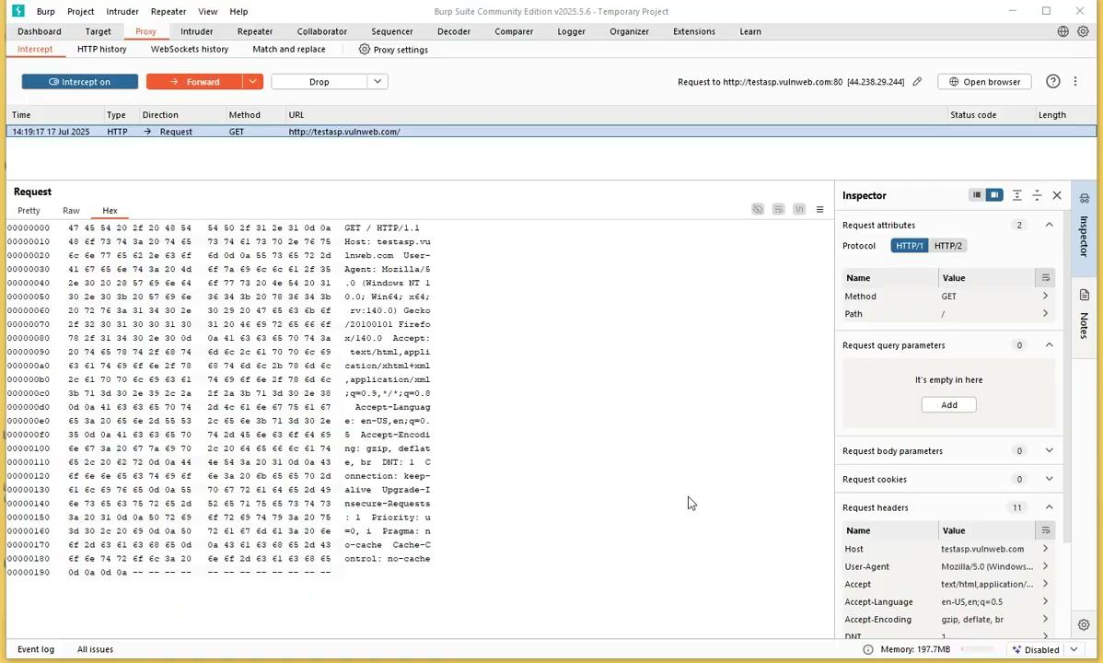

Slide 8
Impact:
Session hijacking
Phishing attacks
Redirection to malicious websites
Recommendation:
Sanitize and encode output.
Use security libraries or frameworks that escape input.
Apply a web application firewall (WAF).

